Slide 1
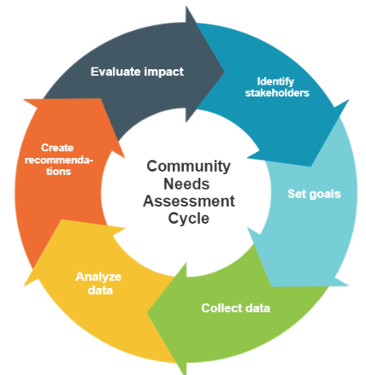
INFO547: Design Thinking for Digital Community Service
Week 2: Understanding Your User Community

Slide 2
Assignment due reminder!
The Group Roles, User Needs, and Reflection assignment is due at the end of next week. Submit it to Blackboard by January 25th at 11:59 p.m. Eastern.

Slide 3
Key Design Thinking Terms
Adapted from: IDEO. (2015). Design thinking for libraries. http://designthinkingforlibraries.com/.
DESIGN CHALLENGE / The project you have chosen as your focus, often described in the form of a “How Might We” question.
DESIGN THINKING / A creative, intentional problem-solving process that puts the user at the center.
EMPATHY / A key principle in the design thinking process and human- centered design, in which the user’s perspective is always represented.

Slide 4
Key Design Thinking Terms
Adapted from: IDEO. (2015). Design thinking for libraries. http://designthinkingforlibraries.com/.
HUMAN-CENTERED (“PEOPLE CENTRIC”) / Putting the user and user’s perspective at the center of a design plan. This philosophy involves starting with people and desirability first before designing solutions.
IDEATE / To come up with lots of ideas. This is an exploratory activity that opens up the imagination to a variety of possibilities. Brainstorming is one way to ideate.
INTERCEPT / Spontaneous, casual, and brief conversations with users in a natural context.
INSIGHTS / Ideas or notions expressed as statements of user behaviors or needs. Insights can provide new understanding of a design problem issue.

Slide 5
Key Design Thinking Terms
Adapted from: IDEO. (2015). Design thinking for libraries. http://designthinkingforlibraries.com/.
STAKEHOLDER / Person or entity is impacted by the design project or solution. Examples of Free Library stakeholders?
USER / A group of customers for whom you are designing. A user group may include those who do not currently use the library.
WORKAROUND / A user’s personal solution to a problem that circumvents official procedures. Observing these behaviors often leads to insights and inspiration for new solutions. Can you think of workarounds you’ve seen people use in libraries or other settings?

Slide 6
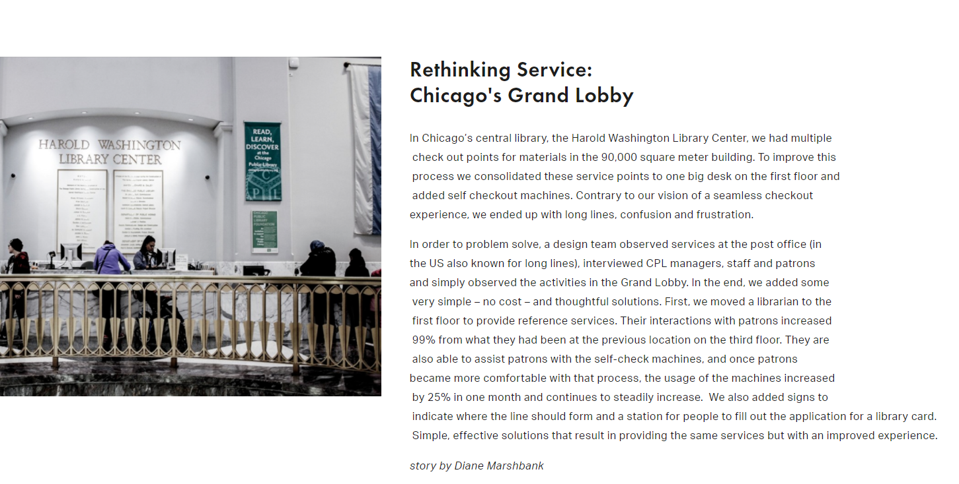
A Design Thinking Example

Slide 7
Design Thinking Example
Marshbank, D. (2020). Rethinking service: Chicago’s grand lobby. Design Thinking for Libraries. http://designthinkingforlibraries.com/service-design
What can we learn about design thinking from this example?

Slide 8
Identifying Target Users
“The first step toward defining your design challenge is to identify a target user group. What we’ve learned over the years is that when you design with ‘everyone’ in mind, you design for no one. The goal of Design Thinking is not to create a one-size-fits-all design project, but to focus on a problem for a particular group of people.” (http://designthinkingforlibraries.com/)
Design thinking solutions should be targeted to a specific user group. Designing for “the public” is usually too broad and makes it difficult to come up with a meaningful “How Might We” question.
Examples of target groups: job seekers, groups that hold genealogy meetings, or teenagers who play video games on computers.
When thinking of designing programs, focus on group needs, not what the library wants. Ask “What needs have we identified for our local teens?” instead of “How do we get more teens to come to the library?”

Slide 9
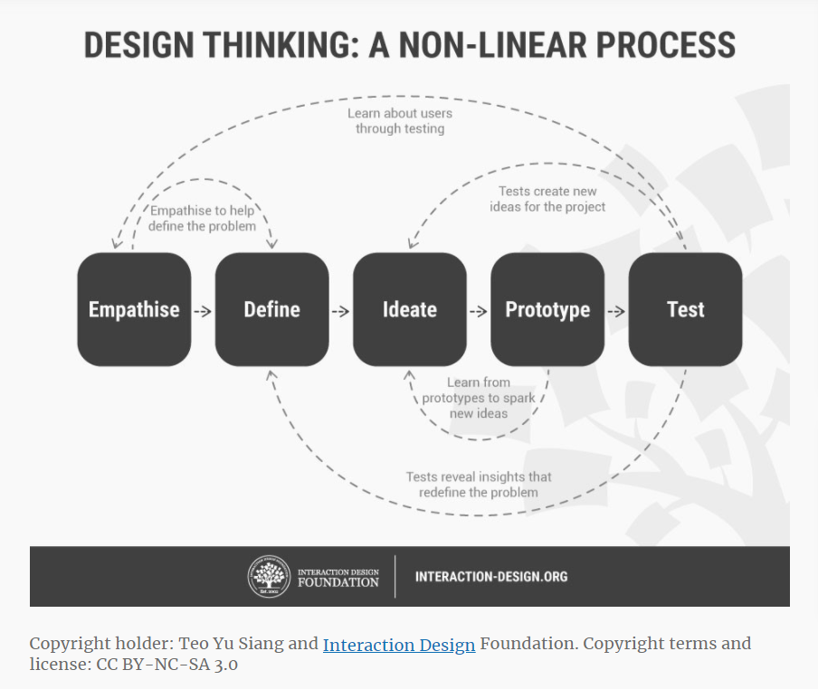
Developing Empathy with Users is Key to Effective Design
From: https://www.interaction-design.org/literature/article/stage-1-in-the-design-thinking-process-empathise-with-your-users

Slide 10
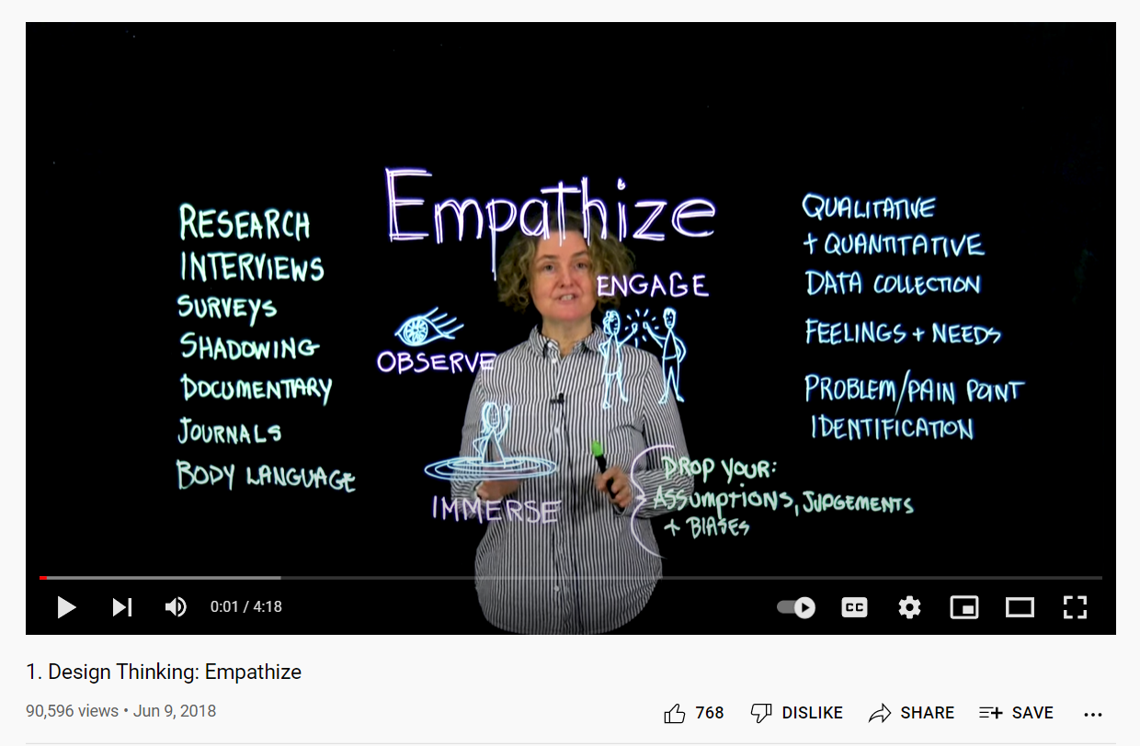

Slide 11
How to Develop Empathy with Users?
Observations and interviews are the two main methods of data collection from users for design thinking projects. Self-reflection and imagination offer additional ways to gather data for understanding the design challenge.
Has anyone conducted any observations or interviews before?

Slide 12
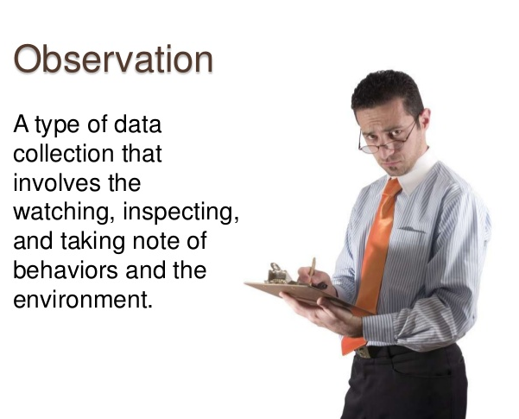
Observation
What is observational research?
Observe people in their environments to understand what people are doing and why
Participant or nonparticipant – examples?
Obtrusive or unobtrusive – examples?
For example, the Chicago Public Library Grand Lobby – What did the designers learn from observing users?
https://image.slidesharecdn.com/observationalstudies-120624223004-phpapp01/95/observational-studies-3-728.jpg?cb=1340578572

Slide 13
Advantages & Disadvantages of Using Observation to Understand User Behaviors and Needs
ADVANTAGES
Observed behavior is authentic, natural behavior
Low demands on designers – little preparation needed
Low demands on users – little participation needed
Helpful for recording users’ behaviors (not beliefs or opinions)
Other advantages?
DISADVANTAGES
Observations can be really tough to interpret
Ethical concerns
Awareness of being observed can lead to changes in behaviors
Other disadvantages?

Slide 14

Interviews/Intercepts
Interviews – predetermined questions
Individual interviews
Focus groups
Intercepts – casual, unplanned conversations to get people’s opinions and ideas – no formal list of questions
What kinds of questions could the Chicago Public Library have asked users during their Grand Lobby redesign project?
How to Do a User Interview

Slide 15
Advantages & Disadvantages of Using Interviews to Understand User Behaviors and Needs
ADVANTAGES
Depth of responses
Can change questions as you go
Low ethical concerns; users can decline to participate
Helpful for understanding users’ needs, values, and beliefs
Other advantages?
DISADVANTAGES
Can take a lot of time to plan and deliver
Users might not have clear ideas of their behaviors and needs
Response bias
Other disadvantages?

Slide 16
Plan your initial interview with your community informant ASAP!
It’s time to reach out to your contact for your first informational interview.
Questions brainstorming…

Slide 17
Another Way to Empathize with Users: Self-Reflection and Imagination
Self-Reflection:
“It is an illusion to think that we are familiar with the lifestyles of all the people for which we develop innovations day after day.” Lewrick, Link, & Leifer, p. 58).
Examples of library services created based on staff ideas of community needs, rather than talking to the community?
Imagination:
Imagine yourself in your users’ positions. What kinds of needs would you have? What kinds of library services would you want?
How could the people working on the Chicago Library’s Grand Lobby have imagined themselves in the users’ position? What could they have done?

Slide 18
Advantages & Disadvantages of Using Self-Reflection and Imagination to Understand User Behaviors and Needs
ADVANTAGES
Inexpensive and easy to conduct
Willing participants
Helps the designer understand his/her/their perspectives and biases
Good starting point; easy way to start
Other advantages?
DISADVANTAGES
Designer might not truly understand the users’ situations and cultures
Limits the range of new ideas
Other disadvantages?

Slide 19
Week 2 Worksheet: Who are Your Users?
Work with your group on the worksheet.

Slide 20

Reminders
Complete the Week 2 worksheet by the end of the week to stay on schedule with your design work for the term!
Do the readings for next week by the beginning of class.
The Group Roles, User Needs, and Reflection assignment is due January 25th. Submit to Blackboard by 11:59 p.m.

