Slide 1
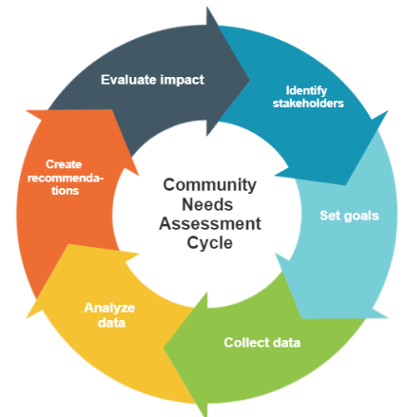
INFO547: Design Thinking for Digital Community Service
Week 1:
Introduction to Design Thinking in Community-Based Information Services

Slide 2
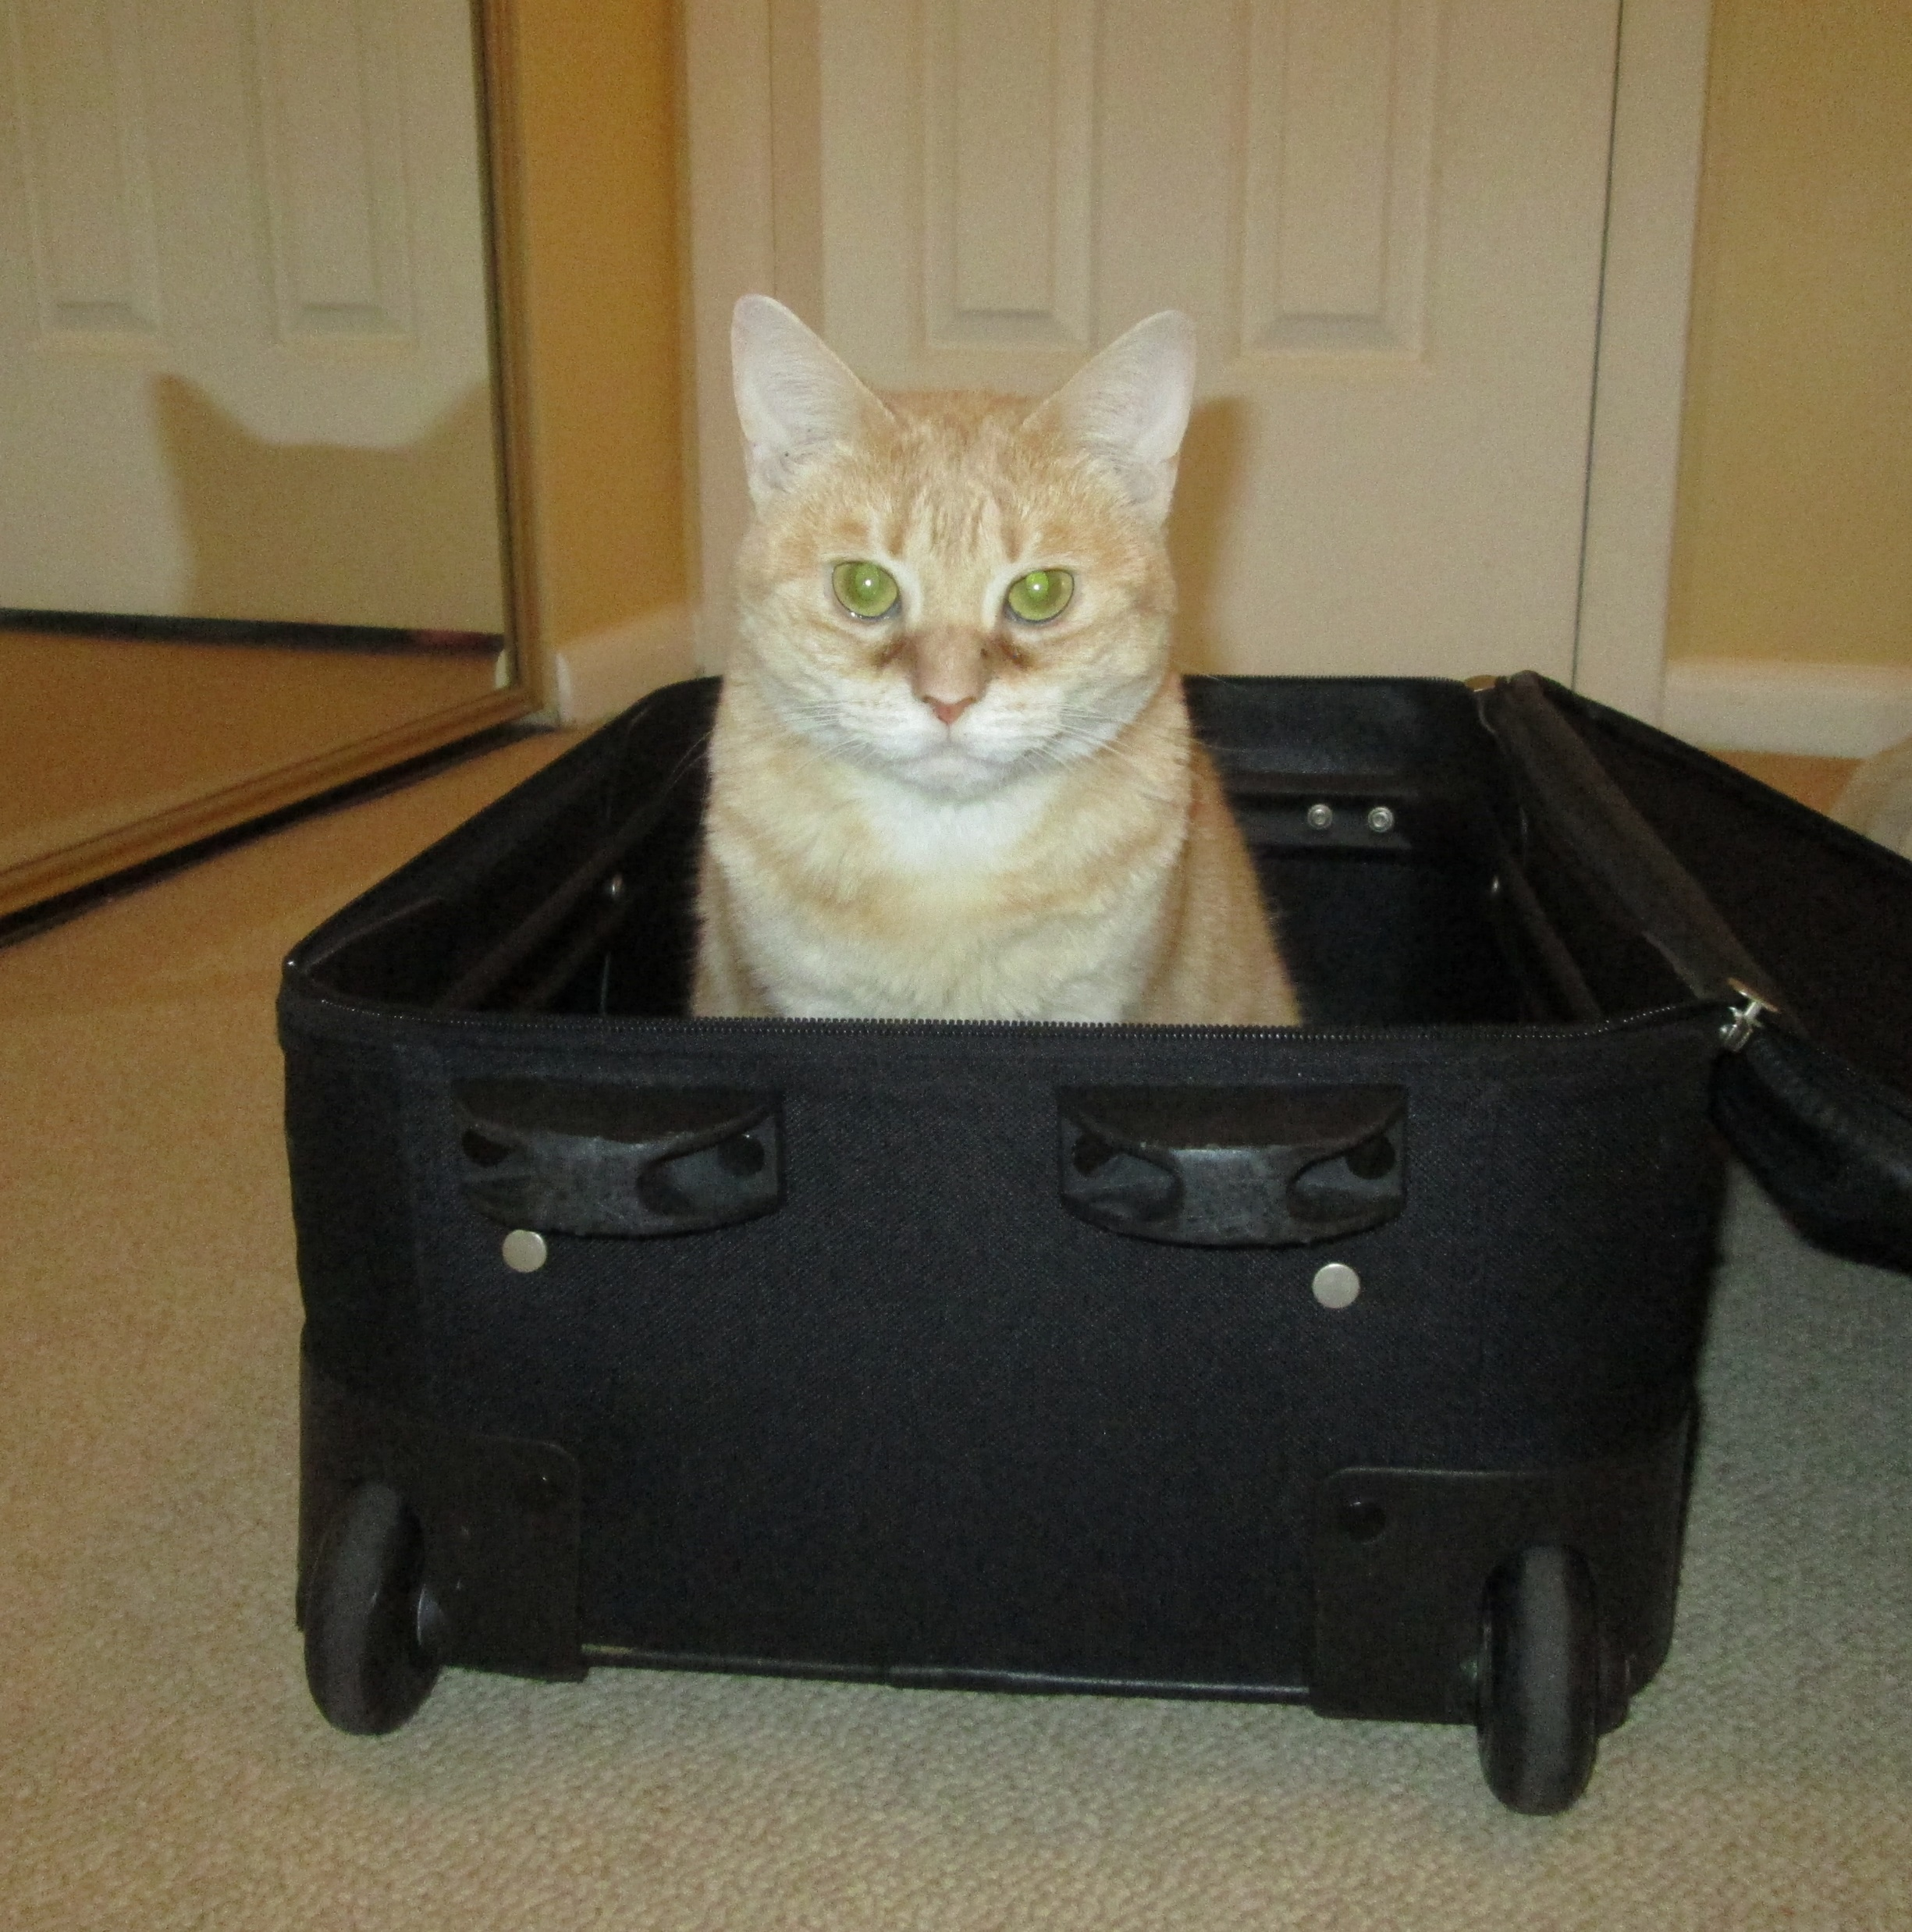
Welcome & Introductions
Welcome to INFO547: Design Thinking for Digital Community Service!
This course is experimental, so we’ll be figuring it out and learning together.
This picture has nothing to do with this slide, but who can resist a cat picture?

Slide 3

Course Learning Outcomes
Explain the major concepts and processes of community information needs analysis.
Describe the major elements of design thinking, with particular focus on digital information service design.
Identify a significant information service need within a target community.
Work collaboratively to design a problem-based information service addressing a community-based information need.

Slide 4
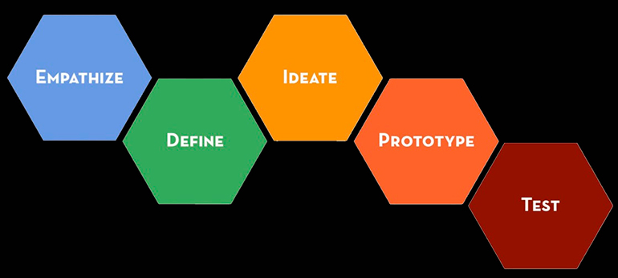
Course Plan
Image credit: https://www.thebigidea.nz/stories/is-design-fiction-the-new-design-thinking
Weekly class sessions on Zoom – live or recorded – your choice!
Design-thinking is group based! Much of the work for this class will be done in groups.
Sign up for a group on Blackboard.
Groups will work with Sam Kirk and John Wiggins, Drexel Libraries:
Sam Kirk John Wiggins
Manager, Curricula Support Director, Services & Quality Improvement
Drexel University Libraries Drexel University Libraries
Hagerty Library, Room L32 Hagerty Library, Room 135
sk3934@drexel.edu jww@drexel.edu

Slide 5
Course Deliverables & Grading
Assignment 1: Group Roles, User Needs, and Reflection: 20%
Assignment 2: Project Goals, Problem Statement, and Reflection: 25%
Assignment 3: Revised Plan, Impact Evaluation, Presentation, and Reflection: 35%
Class participation: 20%
--------------
You may choose to submit your work as a member of your group or individually. Group members will earn the same grade on assignments submitted together.

Slide 6
A Note about What to Expect from This Class
This term you’ll identify a problem to address and create a plan for addressing it. However, there isn’t enough time in one short academic quarter to put the plan into action.
You’ll put the plan you create into action when you do your capstone project, if you choose to work on the same project.

Slide 7
What do libraries mean to you?

Slide 8

Post your introduction to the Week 1 discussion board. Try an audio or video intro (if you want to)! They’re more fun for the rest of us than just text.
Sign up for a working group for the term. Groups are listed on the discussion board.
Either attend this week’s Zoom class or read the Week 1 lecture slides posted on Blackboard with the Week 1 materials.
Complete the assigned readings for this week, as listed on the syllabus.
Work with your group to complete the "Define Your Design Challenge" and "Determine Your Group Roles" worksheets by the end of the week (Tuesday at midnight Eastern). You won't turn them in for a grade this week, but you need to complete them by the end of Week 1 to keep your group on schedule for the term. You’ll submit them in as part of your first written assignment, due at the end of Week 3.

Slide 9
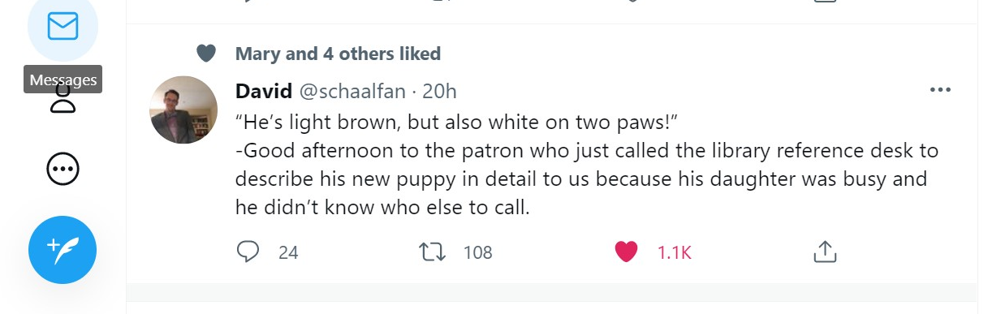
From Twitter, posted 07/13/21

Slide 10
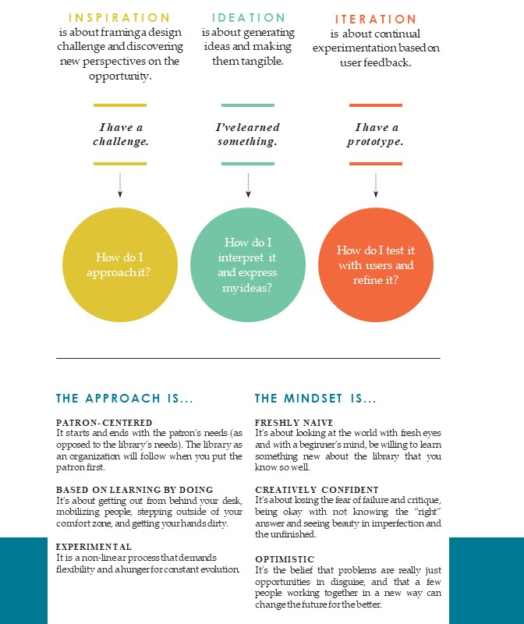
THE DESIGN THINKING PROCESS
From: IDEO. (2015). Design thinking for libraries. http://designthinkingforlibraries.com/.

Slide 11
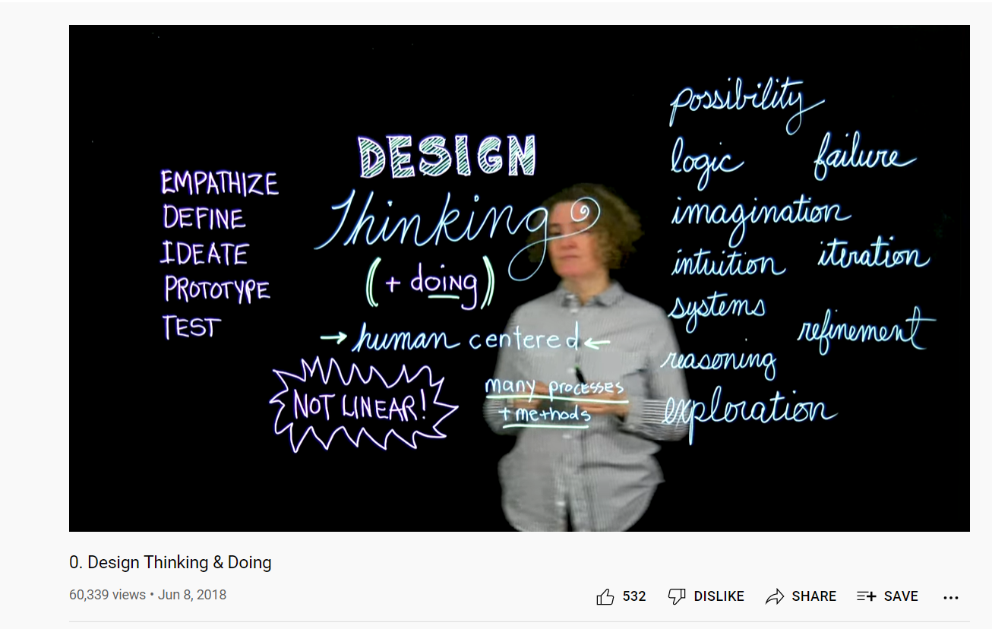

Slide 12
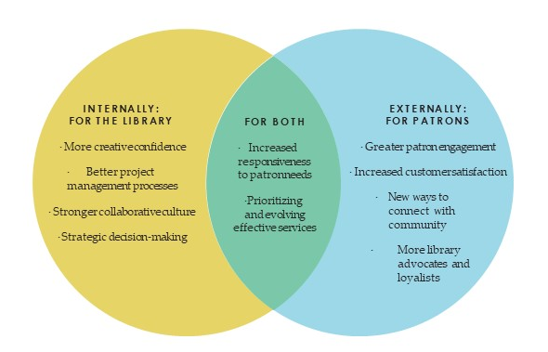
Why is design thinking valuable in libraries and other community institutions?
Image from: IDEO. (2015). Design thinking for libraries. http://designthinkingforlibraries.com/.

Slide 13
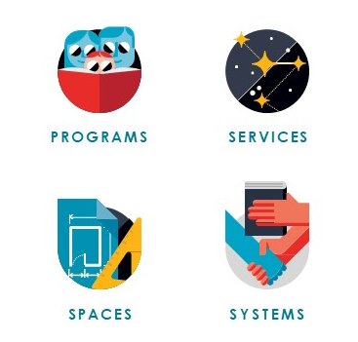
What kinds of challenges can design thinking in libraries address?
Examples?
Image from: IDEO. (2015). Design thinking for libraries. http://designthinkingforlibraries.com/.

Slide 14
An Example of Design Thinking in Libraries
https://www.youtube.com/watch?v=HuvmgV7anmo
What does this video teach us about the design-thinking process?
Why did the design team go to a wine store when their focus was thinking about readers’ advisory (RA) services?
How could add a digital element to the Chicago Public Library’s RA project?
Hmmm…we’re in the middle of a pandemic. How might we get ideas from our target communities this term?

Slide 15

G E T T I N G S TA R T E D with Design Thinking
First you have to choose a design challenge. What is something you have been wanting to change in your library? Think of a few things you may find yourself complaining about or wishing could be better. These are design challenges waiting to be tackled.
For example, you may wish for a better way to engage teenagers in your library. Or maybe you have dreams of creating a co-working center.
We frame design challenges as questions. “How Might We” questions help us come up with impactful solutions and generate as many ideas as possible.
It’s important to find a balance when crafting a good challenge. Ask a question that’s too broad or too narrow. Broad questions are hard to address. Narrow questions limit your possibilities
Adapted from: IDEO. (2015). Design thinking for libraries. http://designthinkingforlibraries.com/.

Slide 16
“How Might We” Questions: Example #1
Too broad: How might we get teenagers to come to the library?
Too narrow: How might we create digital skills classes for teenagers?
Just right: How might we create relevant digital services for underserved teenagers who visit the library after school?
Consider:
Why is the “too broad” question too broad to be a good “How Might We” question?
Why is the “too narrow” question too narrow to be a good “How Might We” question?
Adapted from: IDEO. (2015). Design thinking for libraries. http://designthinkingforlibraries.com/.

Slide 17
“How Might We” Questions: Example #2
Too broad: How might we encourage more play in the library?
Too narrow: How might we encourage children to play with costumes during storytime?
Just right: How might we introduce more play in library events for children who may not be experiencing enough play opportunities at school?
Consider:
Why is the “too broad” question too broad to be a good “How Might We” question?
Why is the “too narrow” question too narrow to be a good “How Might We” question?
Adapted from: IDEO. (2015). Design thinking for libraries. http://designthinkingforlibraries.com/.

Slide 18
Another Design Thinking Example
Marshbank, D. (2020). Rethinking service: Chicago’s grand lobby. Design Thinking for Libraries. http://designthinkingforlibraries.com/service-design
What can we learn about design thinking from this example?

Slide 19
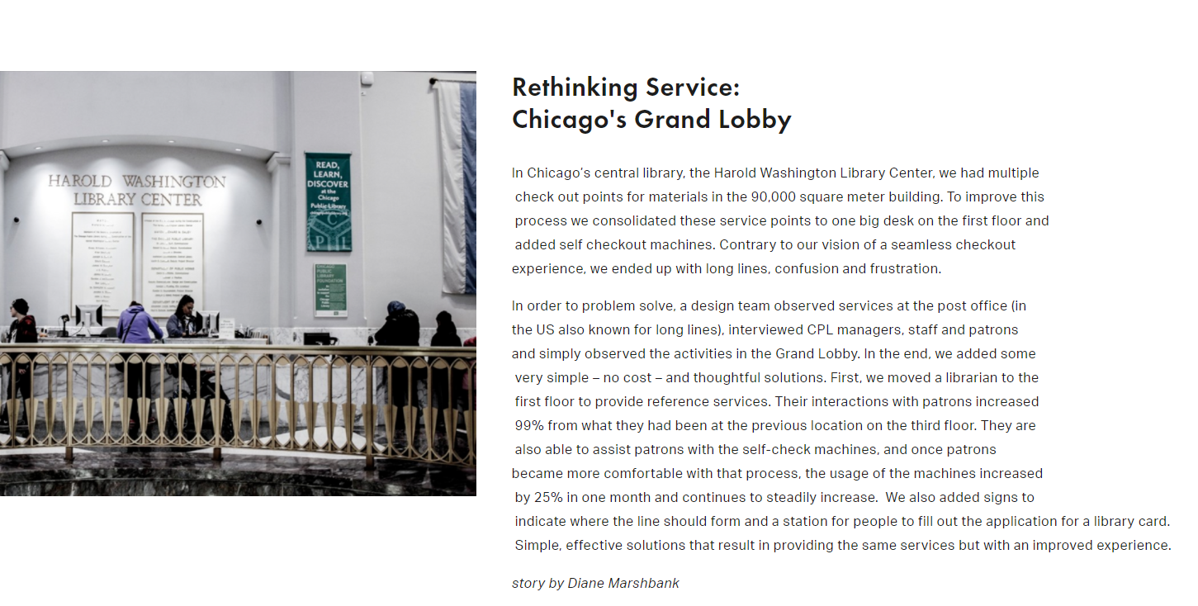

Slide 20
Project Seeds
How can we assess the undergraduate student body's information literacy skills? (e.g. how many of our students can distinguish advertisements from op-eds from analysis and reporting?)
How can we create a service which helps students train themselves to recognize different types of data distortions?
If your group is interested in working on one of these project seeds, next week after your group has gotten organized and completed the first two worksheets, make an appointment for an initial interview with Drexel Libraries’ Sam Kirk here:
https://outlook.office365.com/owa/calendar/CurriculaSupport@drexel0.onmicrosoft.com/bookings/

Slide 21
Project Seeds
How can we curate more diverse collections which reflect the diversity of the student body and their research interests?
We know what informal learning environments can look like in a physical library. What can a library-centric informal learning environment look like online?
If your group is interested in working on one of these project seeds, next week after your group has gotten organized and completed the first two worksheets, email Drexel Libraries’ John Wiggins to set up an initial interview (no more than 30 minutes long): jww@drexel.edu

Slide 22
Week 1 Worksheet #1: Determine Your Group Roles
Take some time to get to know your group members. Discuss: why are you taking this class? What’s your experience in working with community groups? What’s your experience with library and information services? What’s your experience with digital technologies, as a user, as a student, or in work settings?
Now select roles for each member of your group. Group roles: scheduler/project manager, session moderator, library and community specialist, and meeting notetaker. Create a chart including each group member’s name, chosen role(s), and a few sentences about why you chose each role.
Note: Depending on the number of people in your group, you might need to assign people multiple roles, or some of your group members might want to take on the same roles as other members. If you’re unable to work with a group, write a few paragraphs defining your role as a sole project designer and discussing challenges and advantages of working alone on your design project.

Slide 23
Week 1 Worksheet #2: Define Your Design Challenge
Create a list of “How Might We” questions you could address for your design challenge. These are problems in the target community that digital information services could help users to address. Here some are guidelines to follow when crafting your “How Might We” questions:
1. Focus on a specific user group in the library.
2. Make sure your question addresses a problem in the community.
3. Leave room for opportunities to explore multiple solutions.
4. Ensure it is feasible to complete the project in a 10-week timeline.
----------
Save your group’s “How Might We” questions in a file that you’ll be able to access easily in class next week.

Slide 24

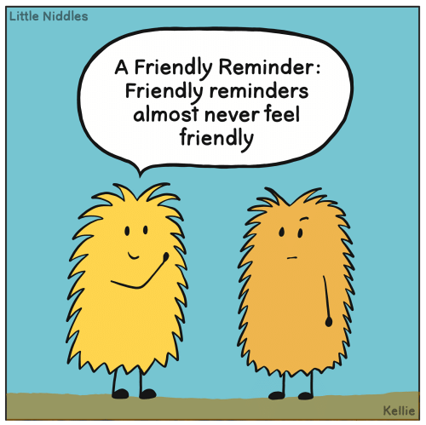
Friendly Reminders
You must complete the first two worksheets by the end of this week to stay on schedule for the term!
Do the readings for next week by the beginning of class.
https://pics.me.me/little-niddles-a-friendly-reminder-friendly-reminders-almost-never-feel-43312776.png

