Slide 1
Week 1
Introduction to data analytics

Slide 2
Welcome and introduction

Slide 3
Hello!
I am Dr. Erjia Yan, associate professor of information science. Yes, the photo is five years old…

Slide 4
Let’s review the syllabus

Slide 5
Grading
Task | Weight | Topic | Due
Course participation | 10% | Class attendance and discussion | Throughout the term
Assignment 1 | 15% | Understanding communities | Week 3
Assignment 2 | 20% | Data collection and analytics | Week 5
Assignment 3 | 20% | Proposal for community partner | Week 7
Final report | 30% | Final report | End of the term
Feedback | 5% | Community partner feedback to project | End of the term

Slide 6
Two threads
Data analytics
Community problem

Slide 7
Options to identify a community partner
There are three options to identify a community partner:
get assigned with a partner by the instructor;
identify a partner by the team; and
team member who has a real-world community problem serving as the partner.
The latter two options require instructor’s confirmation to validate the scope and relevance of the community problem.
The community partner should be identified and communicated with as early as possible, ideally before the end of week 3. If by week 5 the team has not identified a community partner, then the team should self-elect a real-world community problem closely related to members of the team (option 3).

Slide 8
Tools to use
Excel
R
No prior knowledge in programming or statistics is required. We will have lab sessions to provide step-by-step instructions.

Slide 9
Let’s take a 10 min break

Slide 11
Data lifecycle
How would you define lifecycle?
How might it be useful as a heuristic in your own academic/personal/ professional life?
How would you define model?
How do you use models in your own academic/personal/professional life?
How might a model help you make your data reusable?

Slide 12
The lifecycle
Biology:
Birth, maturity, reproduction, death/renewal
Hardware, software, and storage media—any one can fail at any time!
Can trigger loss of access or even loss of data
Integrity, reliability, retrievability, identifiability, usability all jeopardized
Squandered time and effort
E.g. recreation

Slide 13
Example: Digital Curation Profile (DCP)

Slide 14
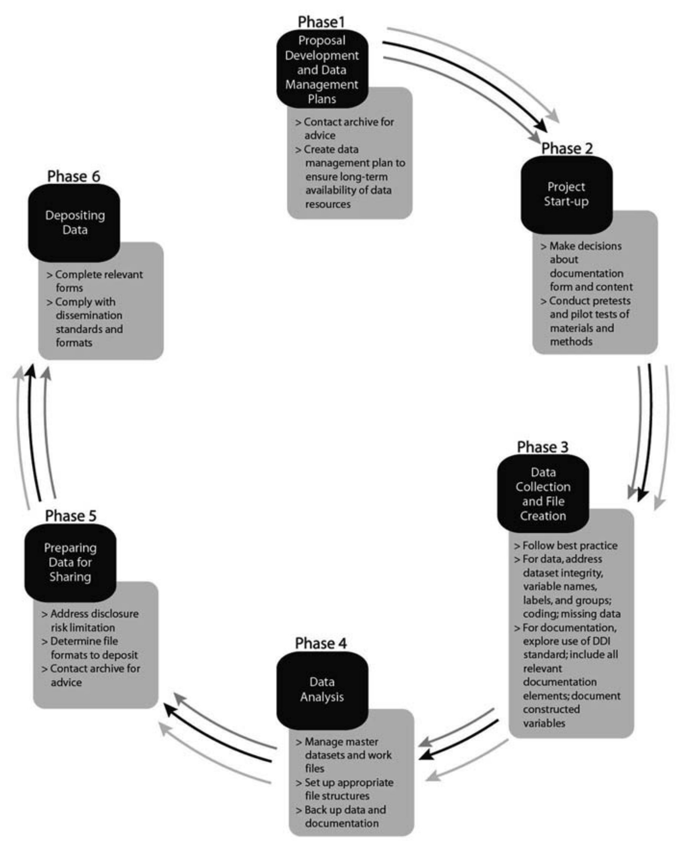
Example: ICPSR
Social science data
Preparation steps matched to each stage of research lifecycle

Slide 15
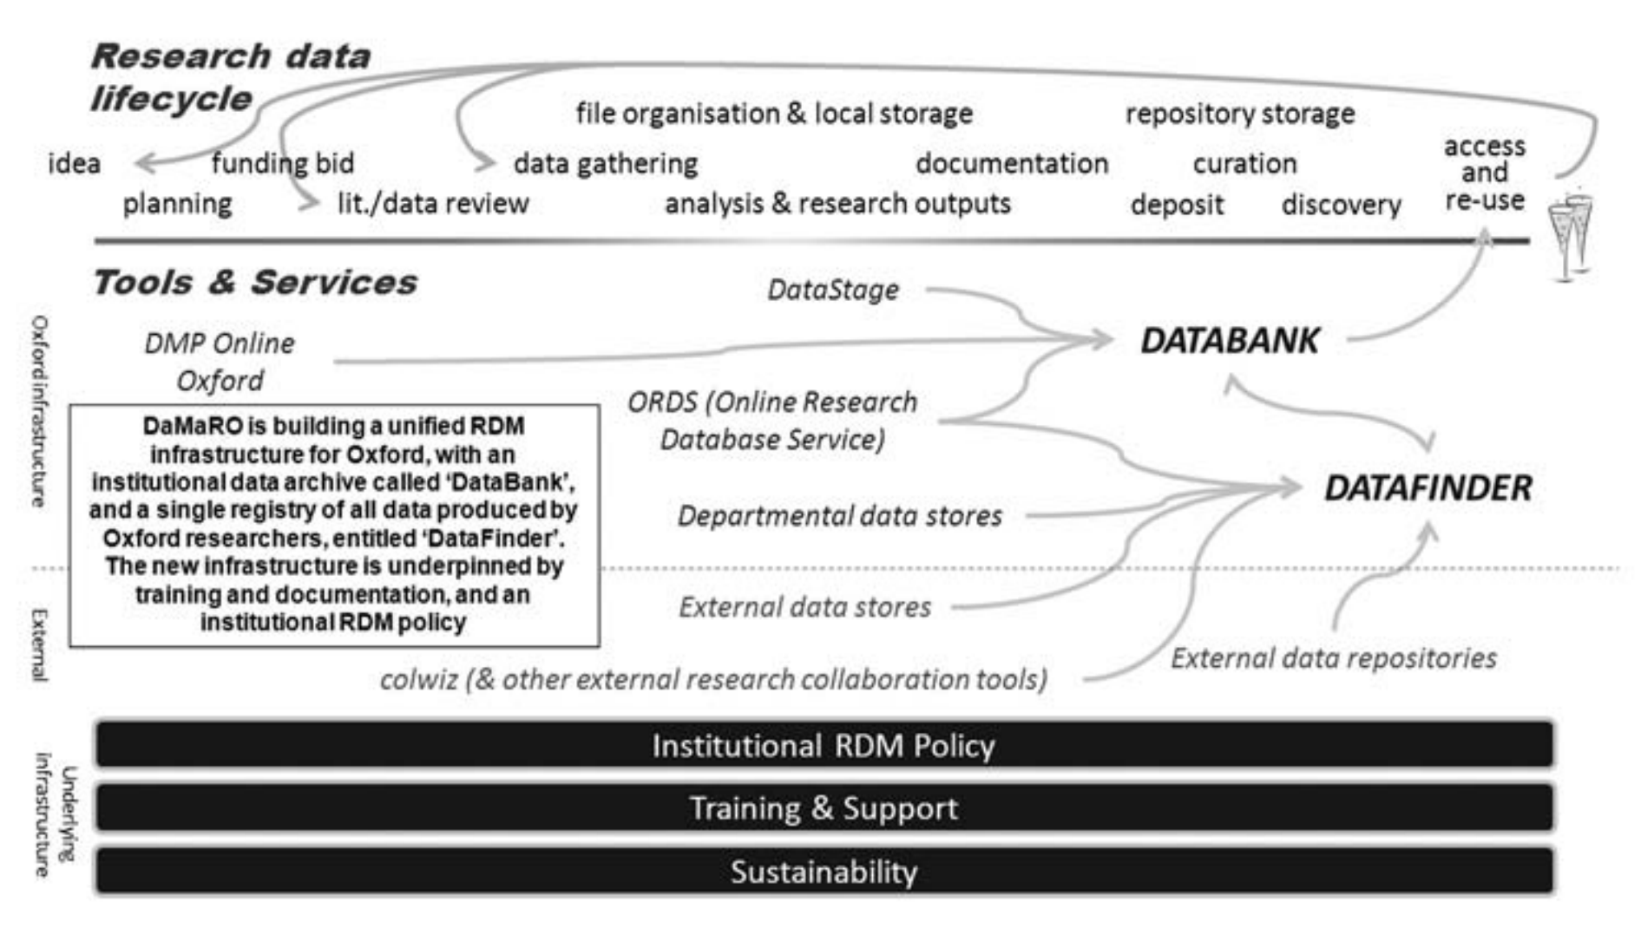
Example: Data Management Rollout at Oxford (DaMaRO)
Strong demand but lack awareness
Guiding principles:
Researcher-centric
Sustainable collaborations
Structure:
Lifecycle actions at top
Links throughout
Data Bank = archive
Data Finder = registry

Slide 16
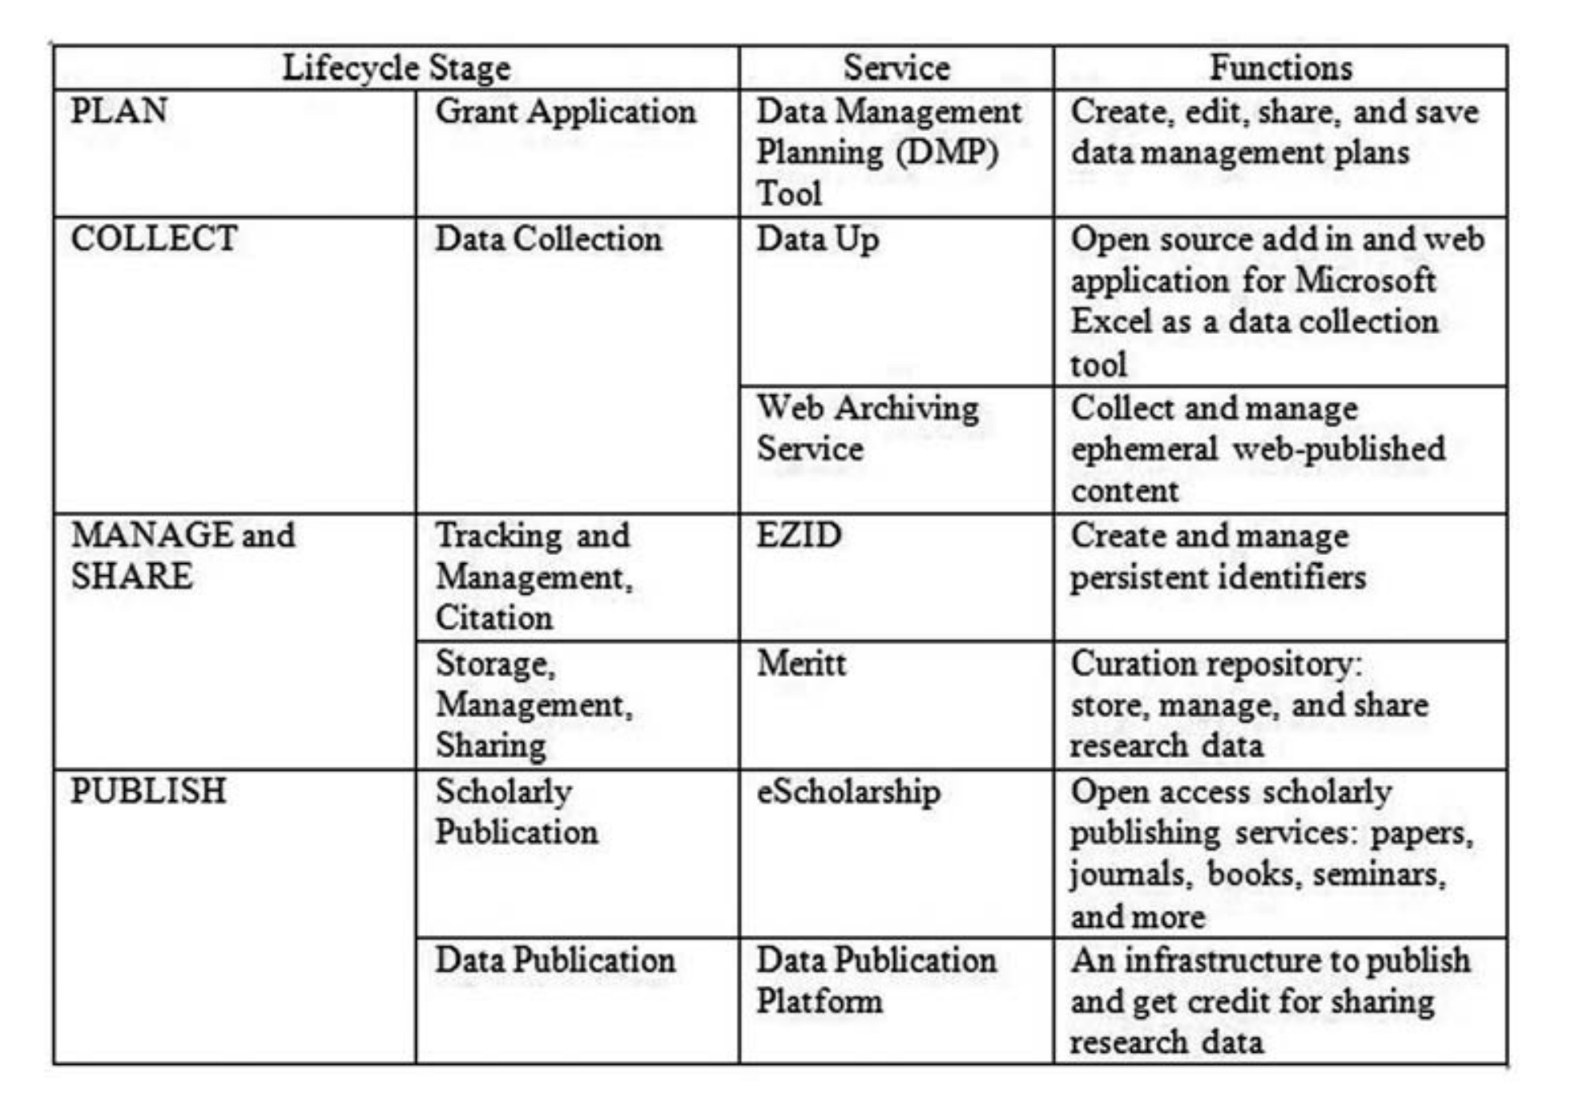
Example: California Digital Library
Focus on UC researchers
Researcher/librarian symbiosis
EZID for citations
DMPTool for DMPs

Slide 17
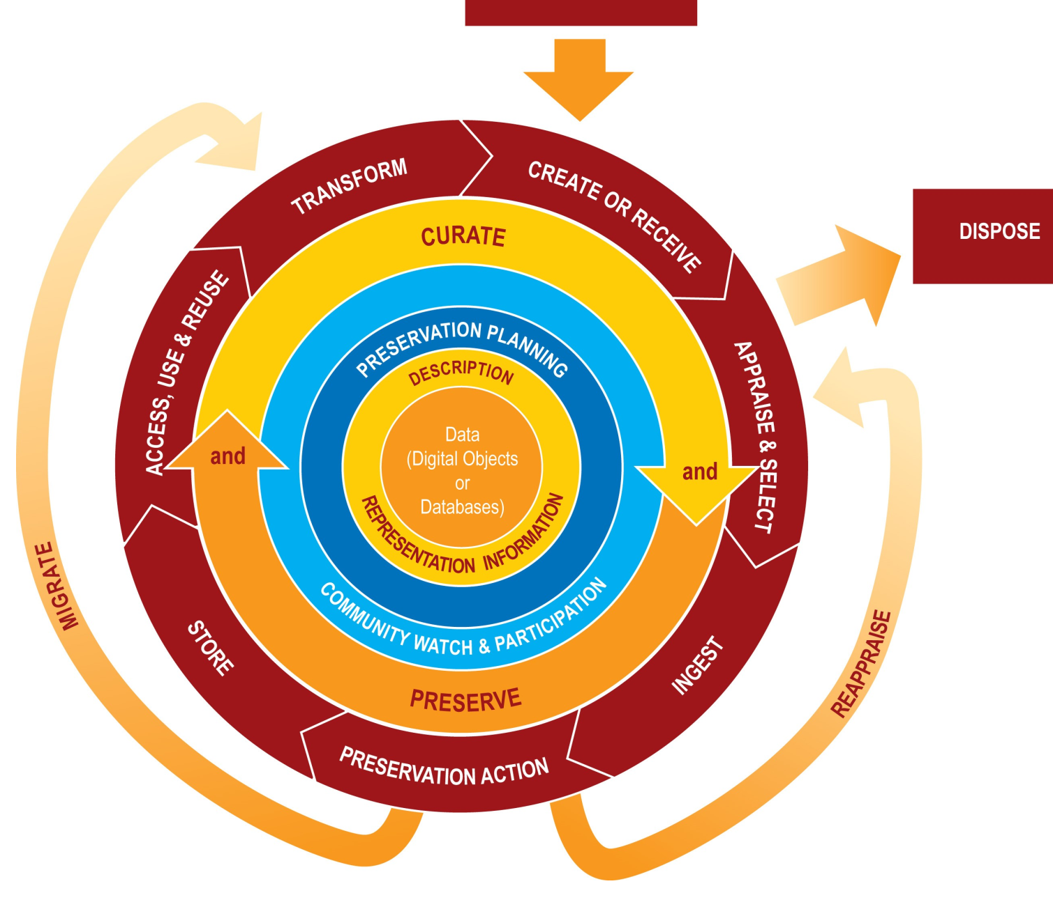
Digital Curation Centre (DCC) Lifecycle Model

Slide 18
Limitations of lifecycle models
1) Idealized
2) Downplay complexity
3) Reflect biases of those who created them

Slide 19
Questions to pose in developing a model
1) Scope
Level of services to be offered?
Audience(s)?
2) Integrating best practices/community standards
3) Representing real world activities
Current practices? Rationale for them?
Any gaps between current and ideal practice?

Slide 20
From our reading: The data life cycle applied to our own data

Slide 21
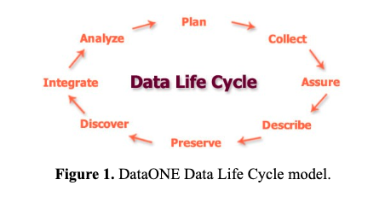
From our reading: Revisiting the Data Lifecycle with Big Data Curation

Slide 22
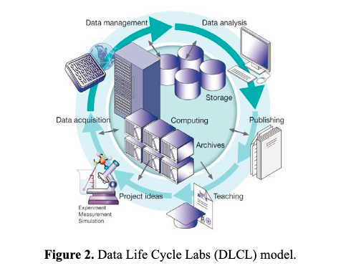

Slide 23
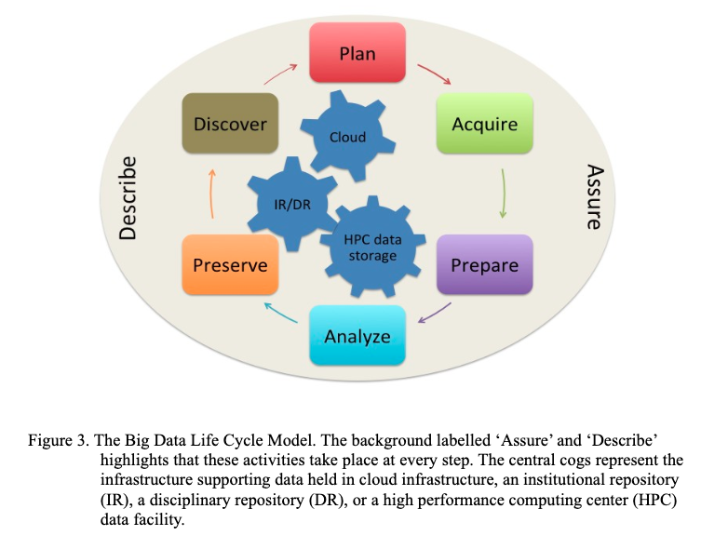

Slide 24
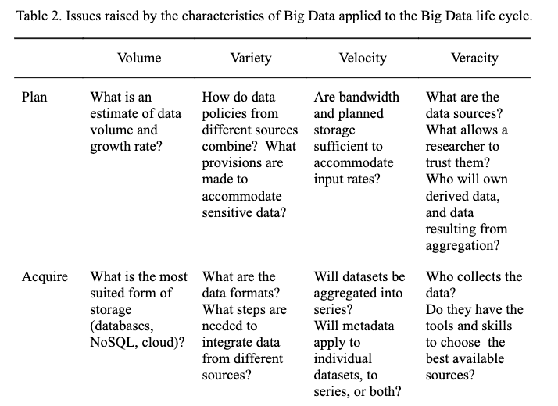

Slide 25
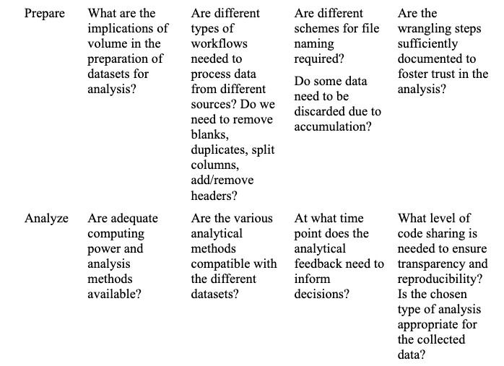

Slide 26
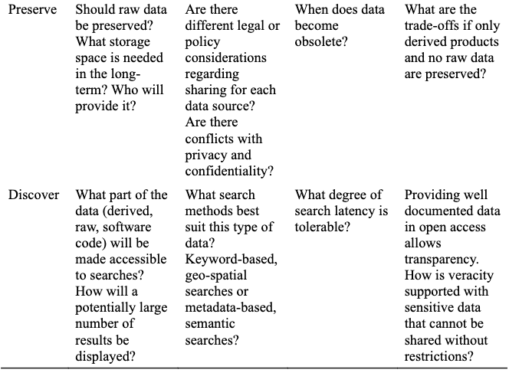

Slide 27
Questions?

