Slide 1
IMLS CBL Project
ZOOM
Advisory board Meeting
Dec. 8, 2020
College of Computing and Informatics
Drexel University
Philadelphia, PA， USA

Slide 2
Agenda
Welcome and introductions
Project Overview and progress report
INFO546: Data Analytics for Community-based Data Service
INFO547: Designing Thinking for Digital Community Service
The spring term – capstone projects
Discussions

Slide 3
The Project Team
Xia Lin, PhD – Professor and Department Head, Information Science, Drexel University
Denise Agosto, PhD – Professor and Director of the Master’s of Science in Information, Information Science, Drexel University
Erjia Yan, PhD – Associate Professor, Information Science, Drexel University
Alex Poole, PhD – Assistant Professor, Information Science, Drexel University
Jane Greenberg, PhD – Professor, Information Science, Drexel University

Slide 4
The Advisory Board
Jennifer Chang – Chief, Central Public Services Division, Free Library of Philadelphia (FLP)
Veronica Britto – Cluster Leader, Free Library of Philadelphia (FLP)
Shannon Oltmann, PhD – Associate Professor, School of Information Science, University of Kentucky
Angela Lindo – Librarian, New York Public Library
Katharine Travaline – Associate Director Programs and Special Projects, Dornsife Center for Neighborhood Partnerships
Jennifer Johnson Kebea, Ed.D. – Executive Director, Lindy Center for Civic Engagement, Drexel University
Carrie Hutnick – Associate Director, Lindy Center for Civic Engagement, Drexel University

Slide 5
The IMLS CBL Project
CBL
  Community-Based Learning
  Community-Based Librarianship
Project Goals
  Develop and implement a Graduate Certificate that can be stand-alone or integrated into an ALA-accredited LIS degree program;
  Educate 12 IMLS Fellows who will have skills and knowledge in design, development, and management of community-based service projects for libraries;
  Develop a community-based learning model for LIS education and sharing the model with other LIS programs nationwide

Slide 6
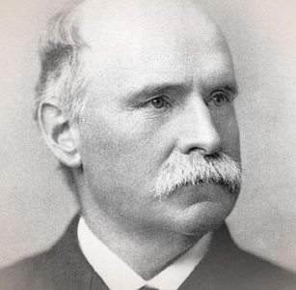
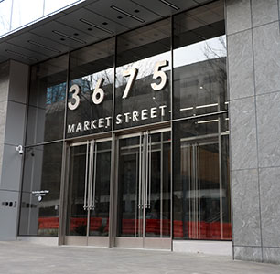
Motivation and Context for the CBL project
Drexel University
  Drexel’s vision: “a University with a difference”
  Fry: most civically-engaged university in United States
Drexel MSI/LIS
  Intersection of people, information, and technology
    Balance theory and practice
    Interpersonal skills
    Practical experience and expertise
    Collaboration across departments/institutions
    A range of information and data-oriented careers
      Information organizations of all types

Slide 7
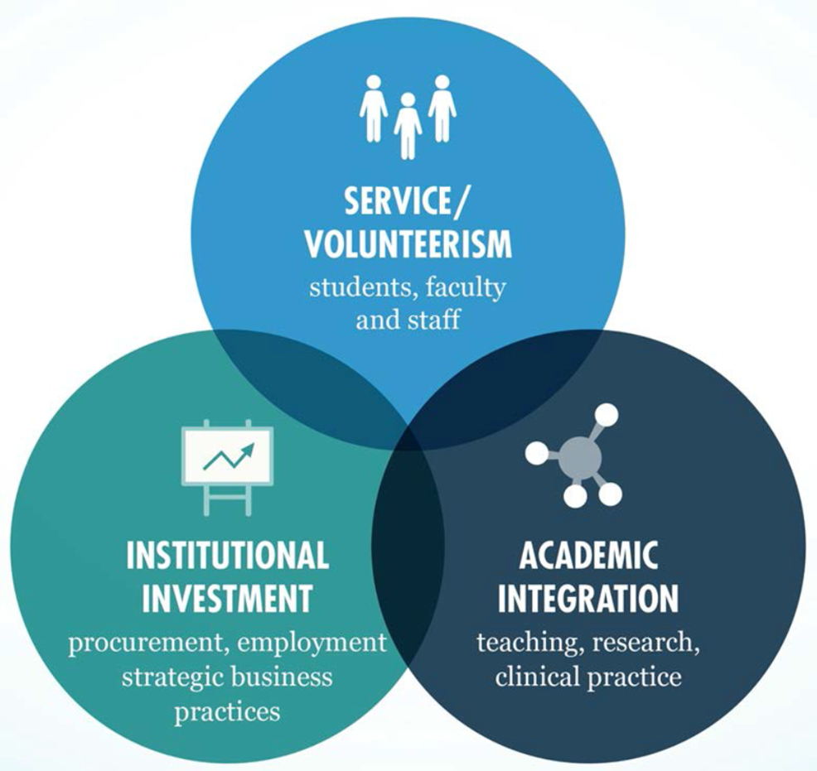
Civic Engagement at Drexel
​
Student and Employee Volunteerism​
Drexel offers high-quality, community-based volunteer opportunities through the Lindy Center for
Civic Engagement, open to all Drexel students, faculty and
professional staff.​
​
Academic Integration​
Drexel faculty explicitly integrate civic engagement into
research, coursework and clinical practice. Our academic
programs allow our students to solve problems on the
ground, interacting with residents, neighboring schools,
community service agencies, and local businesses.​
​
Institutionally Supported Neighborhood Investment​
Drexel serves as an anchor institution in West Philadelphia,
investing fully in the community through hiring and
procurement, and supporting initiatives to improve the
economic opportunity in the surrounding neighborhoods.
Notes:
Research and academic programs that directly benefit communities
Public service by students, faculty, and staff
Business practices that support local and regional economic development
Drexel’s approach aligns its academic expertise and culture of public service with wide-ranging institutional investments to create a collaborative and coordinated strategy.

Slide 8

Community-based librarianship
Democratic civic engagement and renewal
  Civic engagement principles (ensuring civic literacy and an informed citizenry) align with LIS values
Community programming and outreach in U.S. libraries
  Connect with broader and more diverse communities
  Technology and digital and data services
    Digital divide
Community competencies
  Community engagement in the context of library/information services
  User-centric skills in leadership and management
  Critical thinking and problem-solving skills in rapidly evolving communities
  Fostering communication and collaboration skills in culturally diverse and sensitive environments
LIS, diversity, and social justice (Poole et al., forthcoming, JELIS)
Imperative of experiential learning
  Embed selves as fellow community members who co-develop programs and solutions

Slide 9
Community-Based Learning:
a wide variety of instructional methods that educators use to connect classroom learning to the surrounding community. CBL is also motivated by the belief that all communities have intrinsic assets and resources that can enhance learning experiences for students.

Slide 10
The Three year’s IMLS Project
YEAR 1: (July 2019 to June 2020)
  Develop the Certificate
  Promotion and recruitment
YEAR 2: (July 2020 to June 2021)
  Develop and deliver the three courses
  Educate the first cohort of the CBL Fellows
YEAR 3: (July 2021 to June 2022)
  Enhance the three courses and educate the second cohort of Fellows
  Develop the CBL model for LIS education

Slide 11
THE CERTIFICATE
Developed the certificate proposal and submitted it to the Drexel’s Faculty Senate for approval.
The three-course Post-Baccalaureate Certificate in Community-based Librarianship:
Course | Pedagogical Approach
INFO546: Data Analytics for Community-Based Data & Service | Community-based learning
INFO547: Design Thinking for Digital Community Service | Side-by-side learning
INFO890: CBL Capstone Course | Community-based service learning

Slide 12
Certificate Learning Outcomes
Foundational principles, professional ethics and values, and social and technological contexts of information work
Identify and analyze the information needs of various communities
  Design and implement library/information programs and services to meet those needs
Demonstrate core values of the profession (access, equity, intellectual freedom, privacy, social justice)
Encourage information literacy in support of all areas of individual and community needs
  Formal and informal education, career development, healthcare and financial planning, research innovation, and political and social engagement
Use research and data in sophisticated ways
  Demonstrate value of library as community center
  Address individual and community challenges
    Poverty and hunger, population shifts, economic development, preservation of cultural heritage

Slide 13
RECRUITMENT
An Open House on the Certificate of community-based Librarianships (Nov. 2019)
  Excellent responses
    More than 60 people signed up
    More than 40 people attended
    Excitement among the prospective applicants
  Set March 2020, to open the application
When COVID-19 hit
  Interest to the Certificate was down significantly
  Fewer applications were submitted.
Multiple online open houses were hold.

Slide 14
Six IMLS Fellows
Crawford, Sharonda
Eakins, Ainsley Wynn
Hiles, Claudia
Lammers, Khyra
Szondy, Victoria
Williams, Mackenzie

Slide 15
Recruitment for the Next Cohort
Six full-tuition IMLS scholarships for Fall, 2021
More 1-course-tuition CCI scholarships are available
Need to reach out to potential applicants
  How, when, where ?
Need your help and your ideas/advice!

Slide 16
INFO546
Data Analytics for Community-Based Data and Service

Slide 17
Students profile
6 fellows
2 MSI students

Slide 18
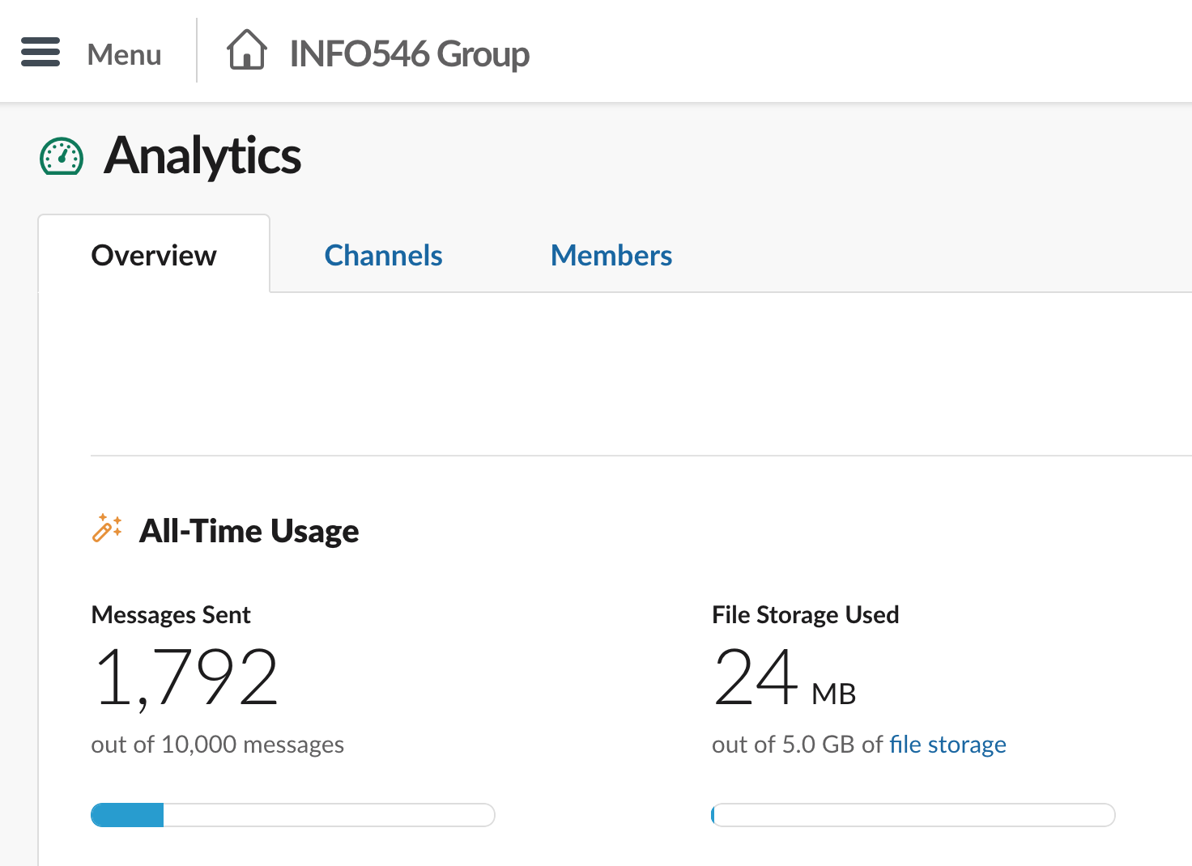
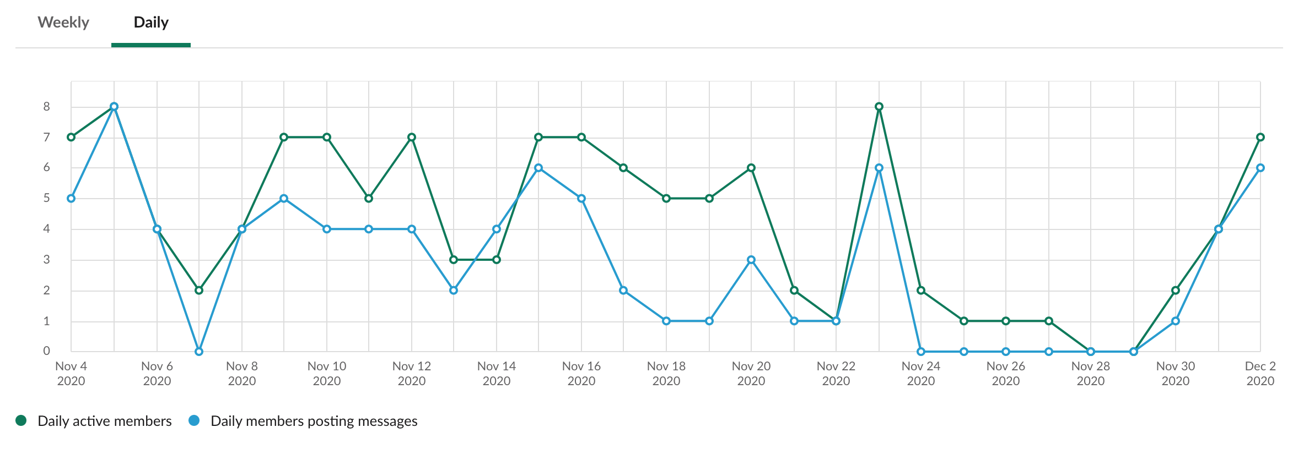
Course format
Asynchronously online
Weekly recordings
Slack discussions

Slide 19
Tools
R Project
  ggplot
Tableau
Readings on community inquiries
  ”frame the issue”

Slide 20
Major course projects
Community issue identification
  3 teams: 3 students, 3 students, 2 students
Community data collection and analytics
  4 teams: 2, 2, 2, 2
Community data project proposal
  2 teams: 4, 4
Final report
  2 teams: 4, 4

Slide 21
Community partners and issues
Philadelphia Student Union (PSU)
  a youth-centered organization facilitated by four central organizers, volunteer student leaders, and youth-led chapters inside schools across Philadelphia
  PSD funding on safety and counseling
  Students identified this partner in week 3 and participated in several meetings with PSU
Oak Lane Community Action Association (OLCAA)
  a local community in north Philadelphia
  Zoning issue, traffic, and food access
  Students identified this partner in week 3 and participated in several meetings with OLCAA including a community

Slide 22
Outcome
Based on the drafts, both teams meet the course objectives in the areas of understanding community problems, data collection, data analytics and visualizations, and communications with community partners
Students also gained skills in using modern data analytics tools such as R and Tableau to make sense of data
Final project report due tomorrow (12/9)

Slide 23
Questions
How can instructors sustain the support of students’ projects beyond the conclusion of the course?
How can we align the course learning objective, students’ interests, and community partners’ interests?

Slide 24
INFO547
Designing Thinking for Digital Community Service

Slide 25
Learning Approaches in Drexel’s CBL Program
Course | Pedagogical Approach
INFO546: Data Analytics for Community-Based Data & Service | community-based learning
INFO547: Design Thinking for Digital Community Service | side-by-side learning
INFO890: CBL Capstone Course | community-based service learning

Slide 26
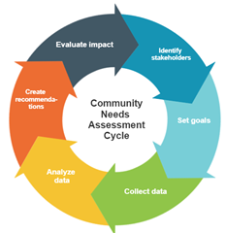
Design Thinking for Digital Community Service: A Side-by-Side Learning Course
Course learning outcomes:
Explain the major concepts and processes of community information needs analysis.
Describe the major elements of design thinking, with particular focus on digital information service design.
Identify a significant information service need within a target community.
Work collaboratively to design a problem-based information service addressing a community-based information need.

Slide 27
Design Thinking for Digital Community Service: A Side-by-Side Learning Course
Side-by-side courses:
are unique to Drexel.
enable non-matriculated community members to take courses with matriculated students.
equalize Drexel students with students who are members of marginalized community groups.
For this course:
Community member participants will be Free Library of Philadelphia employees.
We created abstracts of assigned readings to assist community members taking the course.

Slide 28
Design Thinking for Digital Community Service: A Side-by-Side Learning Course
Assignments
  Community Description and Problem Identification
  Project Plan and Goals
  Data Collection and Analysis
  Project Report, Evaluation Plan, and Recommendations
  Class Discussions

Slide 29
INFO890
CBL Capstone course and projects

Slide 30


Experiential learning
Experiential learning
  Praxis: academic learning with democratic community engagement and civic responsibility
    Connect community engagement to course learning outcomes
  Reciprocity: faculty, students, and community organizations
  Critical reflection
  Payoff:
    Enriched understanding and learning
    Skills development
      Management and leadership
      Teamwork and interpersonal
      Problem-solving and critical thinking
      Technical, citizenship, and lifelong learning
    Career development and professional socialization
Community-based learning (CBL) (Poole et al., under review)
  Work with community, not in service to the community
  Eschew missionary mentality
    Counter negative public perceptions about LIS professionals’ societal roles
  Rhetorical neutrality
    Fruitful blend of collaborative activity, learning, and community building
  “To learn how to be citizens, students must act as citizens” (Melaville et al., 2006, p. 1).

Slide 31
CBL Capstone
INFO547 = pipeline
Individualized culminating experience
  Design activities and apply classroom learning to work or research in intended professional fields
Integrate domain knowledge with communication, organization, research, and other professional skills
Guidelines:
  12 hours per week over ten weeks
  Professional not clerical work
    Project supervisor
  Learning objectives
  3-4 milestones
  Success metrics

Slide 32
Discussion Question 1
Based on your expertise in community information services, information services for marginalized populations, and supporting community access to information, what recommendations do you have for us as we move forward with our work in designing the community-based librarianship certificate program?

Slide 33
Discussion Question 2
What should our students learn and know about Community-based library service?
What else should we do to generate more interest to the Certificate of Community-based Librarianship?

Slide 34
Discussion Question 3
The goal of this grant project is to create a locally-adaptable curriculum that other universities and professional education organizations can build on and adapt. How might the CBL program we’re building be useful in your own organization? What suggestions do you have for making what we’re building more useful to the communities with which you work?

Slide 35
Discussion Question 4
For this project, what may we learn from other community-based learning activities at Drexel and your places?
How should we evaluate/enhance course materials for the three courses?

Slide 36
Open Discussion
Comments, Suggestions?
Next step, next meeting?

Slide 37
Thank you all for your participation!

